Slide 1

Introduction to anatomy

Slide 2
Anatomy is the science that deals with the structure of human body. The term ‘anatomy’ is derived from a Greek word “anatome” meaning cutting up. The term ‘dissecare’ is Latin equivalent of anatome.

Slide 3
HISTORY
Father/founder of anatomy- Herophilus
Founder of Modern Human Anatomy-Andreas Vesalius
Father of Histology-Marcello Malphigi
Father of Medicine-Hippocrates
Father of Genetics-Gregor Johann Mendel

Slide 4
SUBDIVISON OF ANATOMY
1.GROSS ANATOMY 2.MICROSCOPIC ANATOMY
A.Cadaveric anatomy A.Cytology
i.Regional anatomy B.Histology
ii.Systematic anatomy
B.Surface anatomy
C.Comparative anatomy
D.Embryology(Developmental anatomy)
E.Imaging anatomy
F.Pathological anatomy

Slide 5
GROSS ANATOMY
A.Cadaveric Anatomy
Cadaveric anatomy is the type of anatomy where the structures are studied on dead embalmed (preserved) bodies. It can be done by two approaches as follows;
I.Regional anatomy : It is studied in parts like upper limb, lower limb, abdomen, thorax, head and neck.
II.Systematic anatomy : It is basically studied in systems including muscular system, skeletal system, respiratory system,etc.
B.Surface anatomy
This sub-division of anatomy involves study of deeper parts of body in relation to the skin surface. It is also known as topographic anatomy.
Eg. Palpating the artery.
C.Comparative anatomy
t is the study of anatomy of other animals to explain the changes in formed, structure and function (morphology) of different parts of human body.

Slide 6
B.Surface anatomy
This sub-division of anatomy involves study of deeper parts of body in relation to the skin surface. It is also known as topographic anatomy.
Eg. Palpating the artery.
C.Comparative anatomy
It is the study of anatomy of other animals to explain the changes in formed, structure and function (morphology) of different parts of human body.
D. Embryology (Developmental) anatomy
Study of prenatal developmental changes in an individual. Here, the developmental history is called ‘ontogeny’ and evolutionary history is called ‘phylogeny’.

Slide 7
E. Imaging anatomy
•It is the study of bones and deeper organs by plane and contrast radiography, by USG and CT-scan. Hence, it is also known as radiographic anatomy.
F. Pathological anatomy
•It is a branch of anatomy concerned with structural changes accompanying disease.
2. Microscopic anatomy
Microscopic anatomy is a branch of anatomy that relies on the use of microscopes to examine the smallest structure of the body; tissues, cells, etc.
It is further divided as; A.Cytology
B.Histology

Slide 8
LANGUAGE OF ANATOMY
1.Position of body
a.Anatomical Position
b.Fundamental Position
c.Supine Position
d.Prone Position
e.Recumbent Position
f.Lithotomy Position
2. Regional Names
Axial region
Appendicular region

Slide 9
3.Planes:
a.Median/mid- sagittal plane
b.Sagittal plane
c.Coronal plane
d.Horizontal/Transverse plane
4.Terms:
a.Ventral/anterior
b.Dorsal/posterior

Slide 10
c.Medial
d.Lateral
e.Superficial
f.Deep
g.Ipsilateral
h.Contralateral
i.Palmar
j.Cranial/cephalic/rostral
k.Caudal

Slide 11
5.Terms of Movement:
a.Gliding movement
b.Angular movement
i.Flexion
ii.Extension
iii.Abduction
iv.Adduction
v.Circumduction
vi.Lateral flexion

Slide 12
6.Rotation:
a.Medial Rotation
b.Lateral Rotation
7.Special Movement:
a. pronation
b.Supination
c.Opposition of thumb
d.Circumduction of thumb
e.Dorsiflexion of foot
f.Plantar flexion of foot

Slide 13
g.Inversion of foot
h.Eversion of foot
i.Protraction
j.Retraction

Slide 14
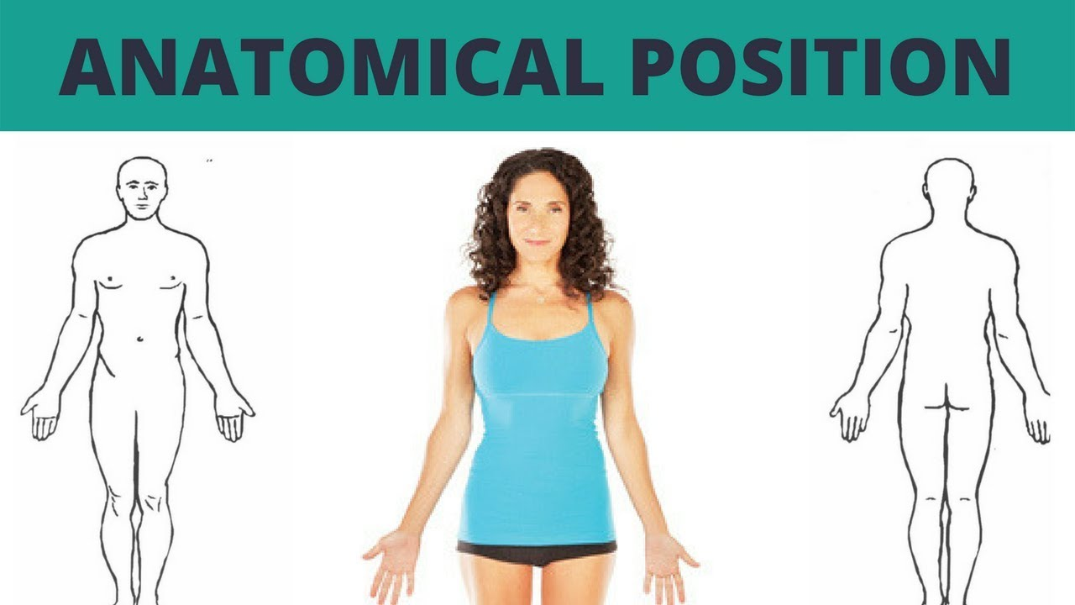
ANATOMICAL POSITION
A person with following characteristics is said to be in anatomical position:
a.Standing straight with eyes looking forwards
b.Both arms by the side of body
c.Palms facing forwards
d.Both feet together

Slide 15
FUNDAMENTAL POSITION
It is same as the anatomical position except that the palms of the hand face the sides of body.This position is often used in discussing rotation of upper limbs such as pronation and supination.

Slide 16
SUPINE POSITION
Person lying on his/her back ,arms by side,palms facing upwards and feet put together.
PRONE POSITION
Person lying on his/her face,chest and abdomen.

Slide 17
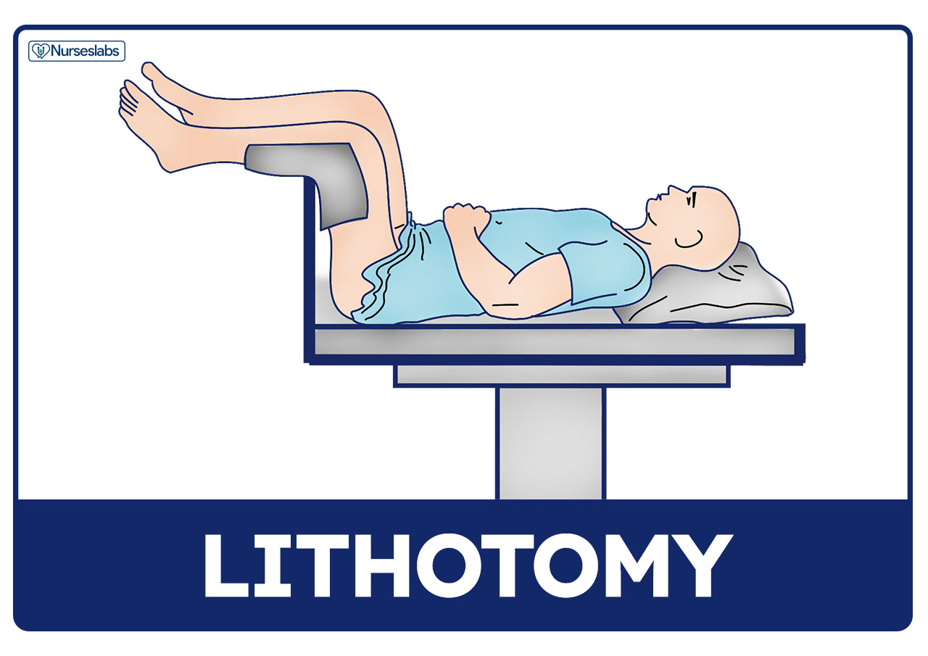
LITHOTOMY POSITION
The lithotomy position is similar to the supine position of the body when the patient is face-up ,arms to the sides ,bt the legs are separated ,raised, and supported in a boot -style leg holder or stirrup-style position .

Slide 18
RECUMBENT POSITION
Lying down.

Slide 19
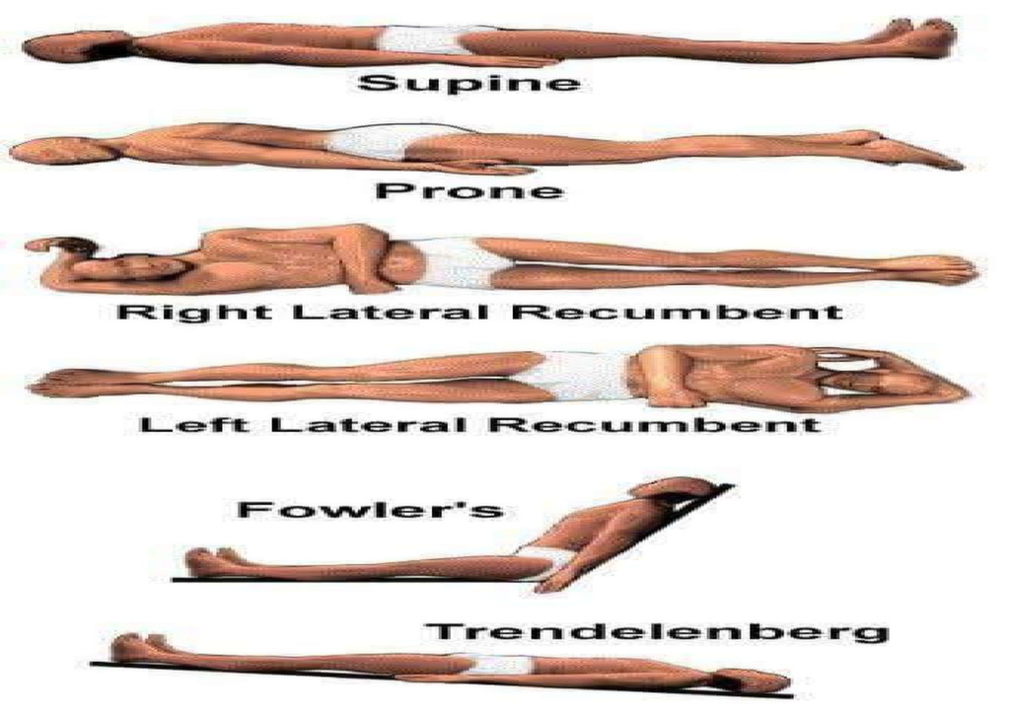

Slide 20
Planes
a) Mid- saggital / Median plane:This plane divides the body into equal right and left portions.
b)sagittal(Longitudinal plane):This plane separates the left and right sides of the body. It is parallel to the median plane.
c) Coronal (Frontal) plane:
It separates the front (anterior) and back (posterior) of the body.
d) Transverse (Horizontal) plane:
This separates the upper (superior) and lower (inferior) halves of the body. It is at right angle to both saggital and coronal planes.

Slide 21
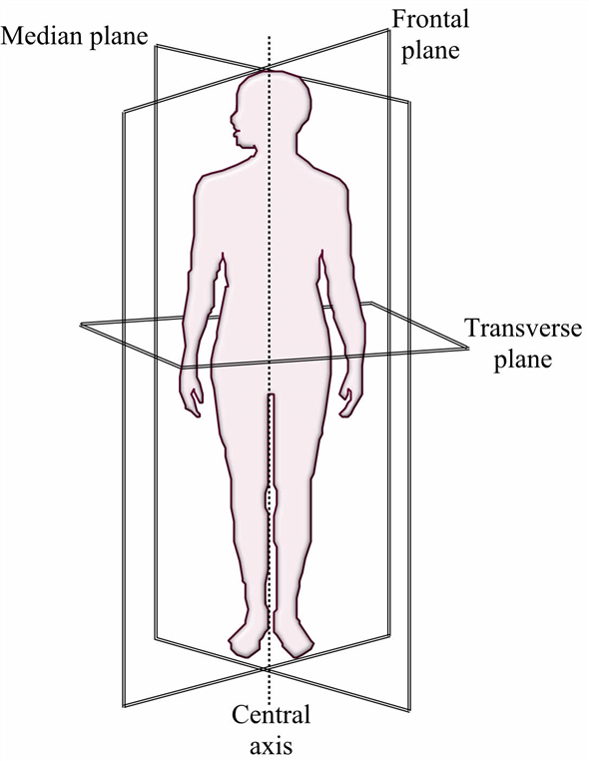

Slide 22
Directional terms
•Anterior/ Ventral : nearer to or at a front of body
•Posterior/ Dorsal : nearer to or at the back of a body
•Medial : plane close to the median plane
•Lateral : plane away from median plane
•Ipsilateral : on the same side of body
•Palmar : front of palm
•Superior/ Cranial / Cephalic / Rostral : towards the upper part/ head
•Inferior/ Caudal : away from head; toward the tail

Slide 23
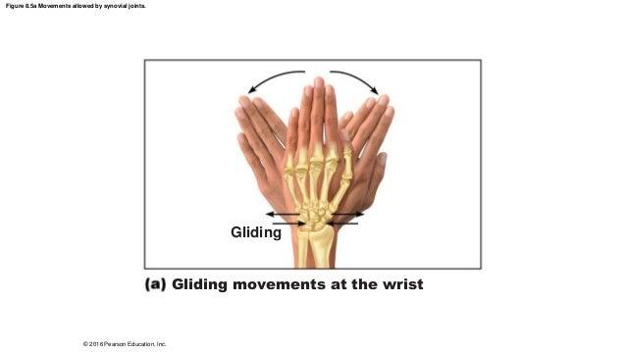
Terms of movement
Gliding movement:
Relatively flat surfaces move back and forth and from side to side with respect to one another. Eg.movement between carpal bones.

Slide 24
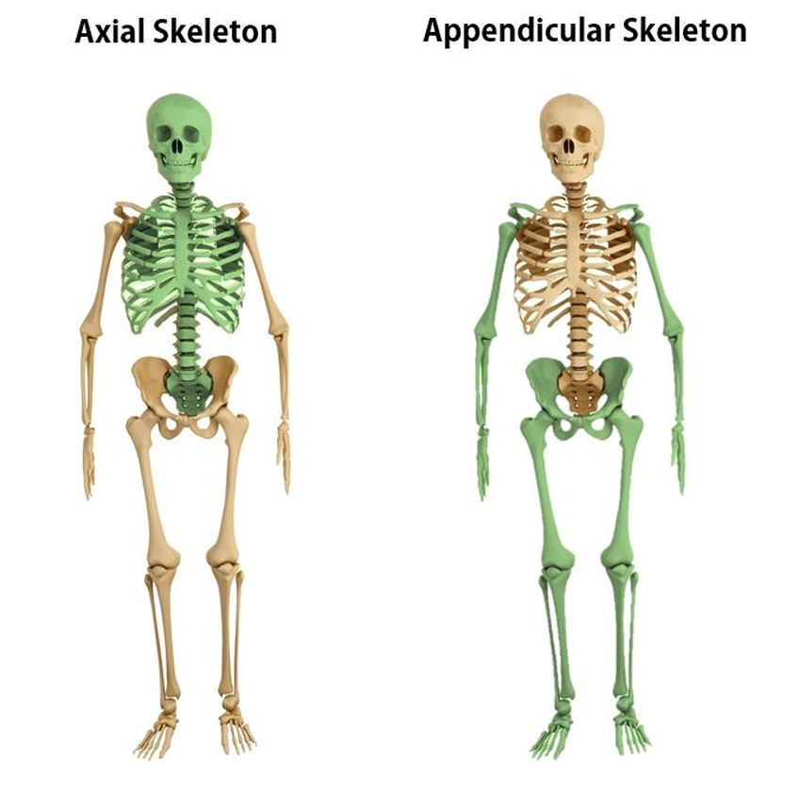
Regional Names
Axial region:
The axial region includes the head, neck, and
trunk which comprise the main vertical
axis of our body .
Appendicular region :
our limbs, or appendages, attach to the body’s
axis and make up the appendicular region
of our body.

Slide 25
B. Angular movement:
Angle between articulating bone decreases or increases as:
Flexion – Making a decrease in angle between articulating bones and flexor surfaces Eg, in elbow joint, when front of arm and forearm are opposed to each other..
Extension – Making an increase in angle between articulating bones and extensor or dorsal surfaces in as much approximation as possible. Eg; straighten arm and forearm at elbow joint.
Lateral Flexion - Movement of trunk sideways to right/ left as waist.
Abduction – Moving away from midline of the body
To “take away”

Slide 26
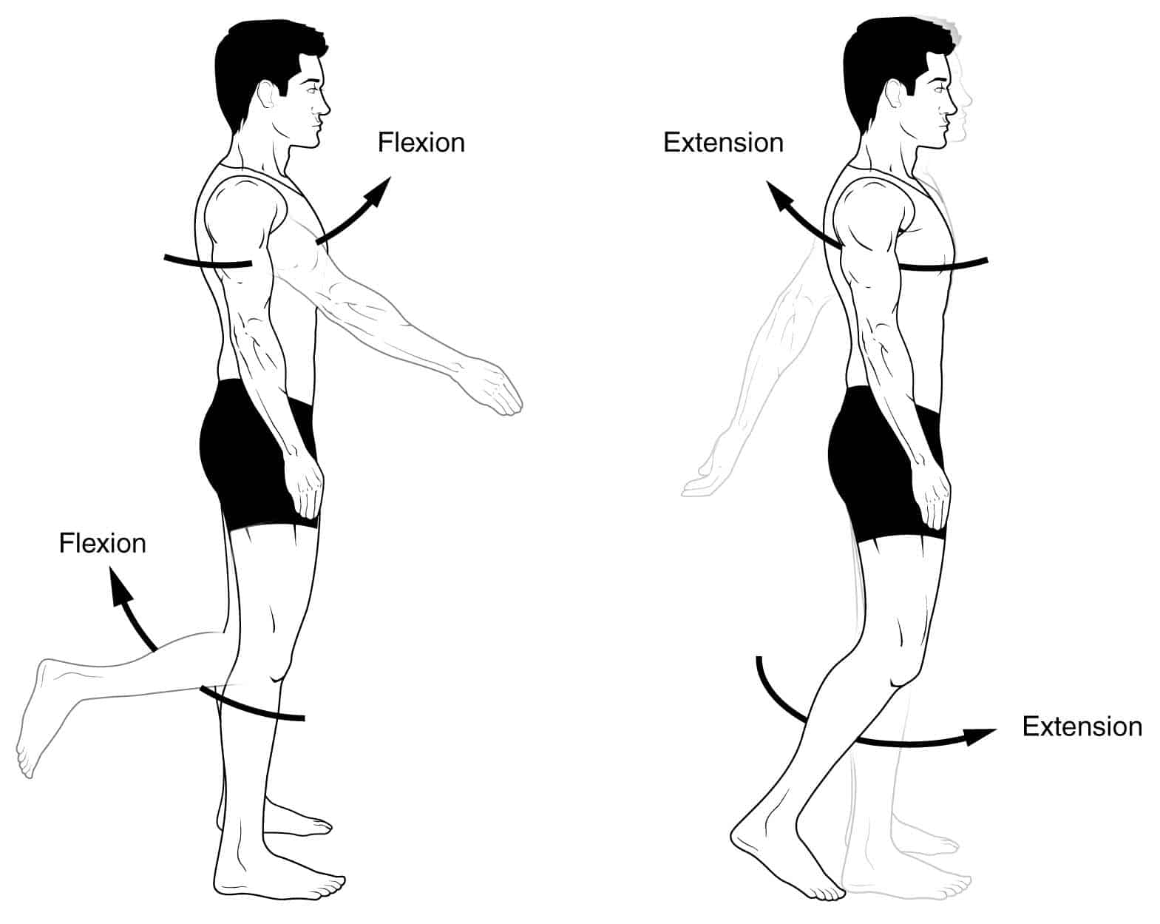
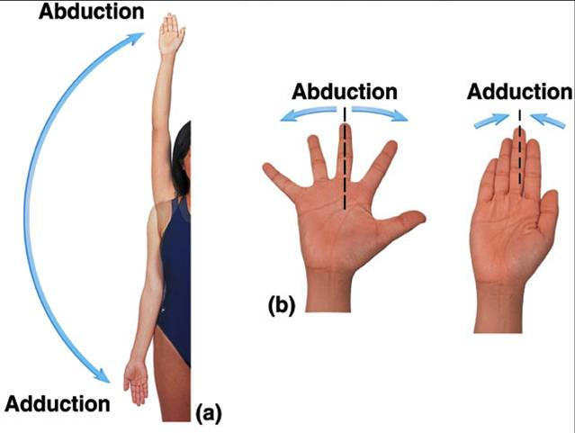
e. Adduction – Moving towards the midline of body
– To “add
f. Circumduction - Movement of distal part of body in circle with combination of extension, abduction, flexion and adduction in a sequence.

Slide 27
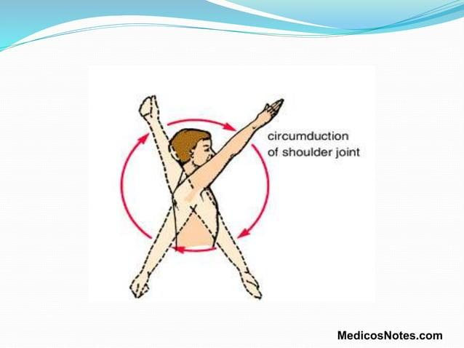

Slide 28
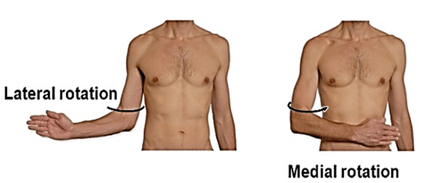
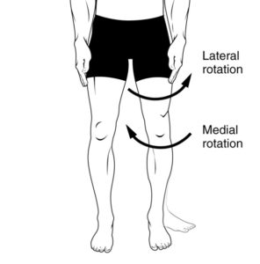
ROTATION
A bone revolves around its own longitudinal axis.
a.Medial rotation:Anterior surface of bone of imb is turned towards midline.
b.Lateral rotation:Anterior surface of bone of limb is turned away from midline.

Slide 29
SPECIAL MOVEMENTS
■Supination – Rotating hand/forearm laterally
– “hold the soup”
■ Pronation – Rotating hand/forearm medially
– “pour the soup”
■ Plantarflexion – Point toes/foot downward
– “stand on tip toes”
■ Dorsiflexion – Point toes/foot upward
– “foot off the gas pedal

Slide 30
■Protraction – Moving forward on plane parallel to ground
■ Retraction – Moving backward on plane parallel to ground
■Opposition of thumb - When tip of thumb touches the tips of any fingers
■ Circumduction of thumb: Movements of thumb with extension, abduction, flexion and extension in sequence.
■ Inversion of foot - When medial border of foot is raised from ground and sole of foot faces medially.
■ Eversion of foot- When lateral border of foot is raised from ground and sole faces laterally.

Slide 31
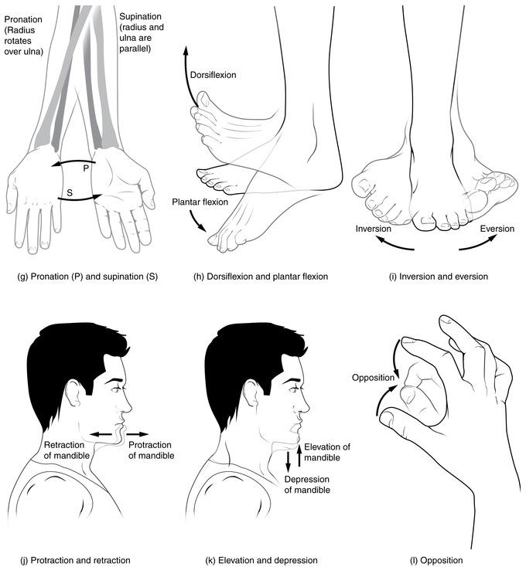

Slide 32
CELL AND ITS STRUCTURE

Slide 33
COMPONENTS OF CELL
Cell Membrane
Nucleus
Mitochondria
Lysosome
Endoplasmic Reticulum
Peroxiosome
Golgi Apparatus
Ribosome
Microtubule
Microfilament
Cilia and Flagella

Slide 34
a. Cell membrane
- envelopes cell
- is thin ,pliable,elastic structure .
- 7.5-10 nm thick
- Lipoprotein in nature
- Contain proteins(55%),phospholipids(25%),cholesterol(13%),other lipids(4%),carbohydrates(3%).
-lipid bilayer with proteins scattered.
-hydrophobic part of lipid bilayer remains in middle whereas hydrophilic part remains in interior and outer surface.
-lipid layer of middle of membrane is impermeable to water soluble substances as ion, glucose and urea.
-but fat-soluble substances as oxygen ,co2,alcohol,can easily penetrate the membrane .

Slide 35
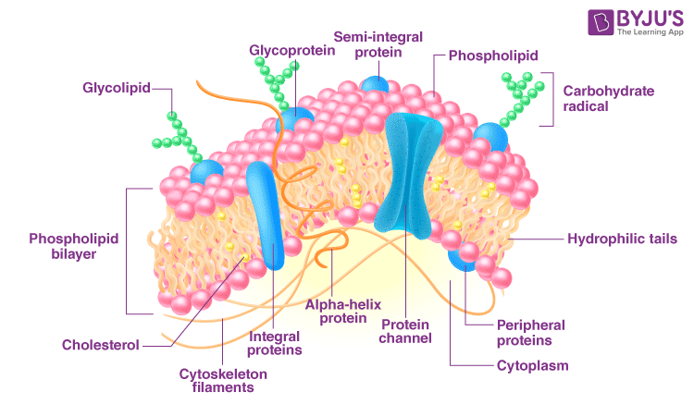
Fig; Plasma Membrane

Slide 36
b.Nucleus
Contain the genetic material DNA
Covered by a bilayer called nuclear membrane
Functions
Control center of cell
Helps in cell division
Protein synthesis
Genetic control of all enzymes, hormones, functions of cell

Slide 37
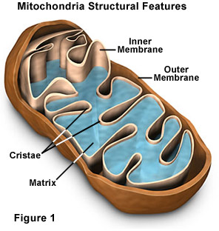
C. Mitochondria
Powerhouse of cell
Covered by lipid bilayered protein membranes.
Its inner infoldings are called cristae
Cristae contains enzymes for oxidative process.
Functions
ATP productionv
RNA and protein synthesis
Concentrates calcium ions

Slide 38
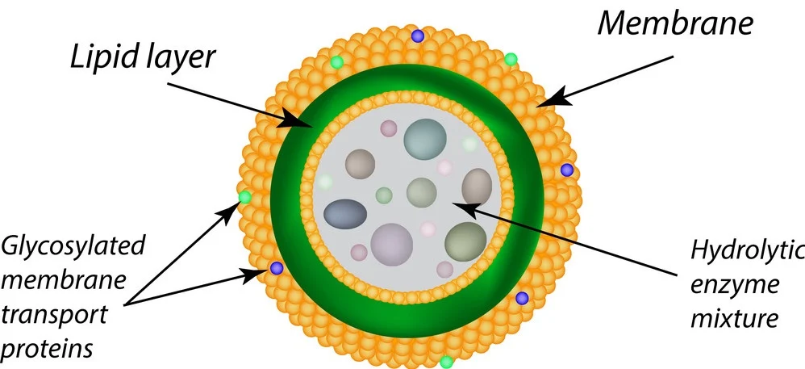
d. Lysosome
Formed from broken vesicles of Golgi apparatus
Also called suicidal bag as it is capable to digestcell itself by autophagic action
Function
Provide intracellular digestive system that help digestion of food particles ingested by cell

Slide 39
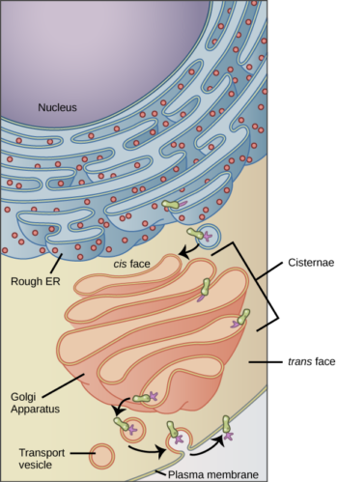
E. Endoplasmic Reticulum
Contains three elements as cisternae,
Vesicle and tubule
Functions
Produce enzymes for lysosome
Synthesis of glycogen, lipid and protein
2 types:
Smooth ER
Rough ER

Slide 40
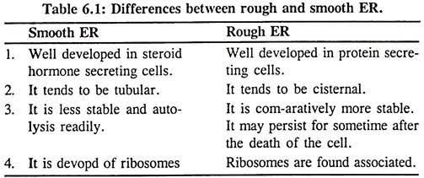

Slide 41
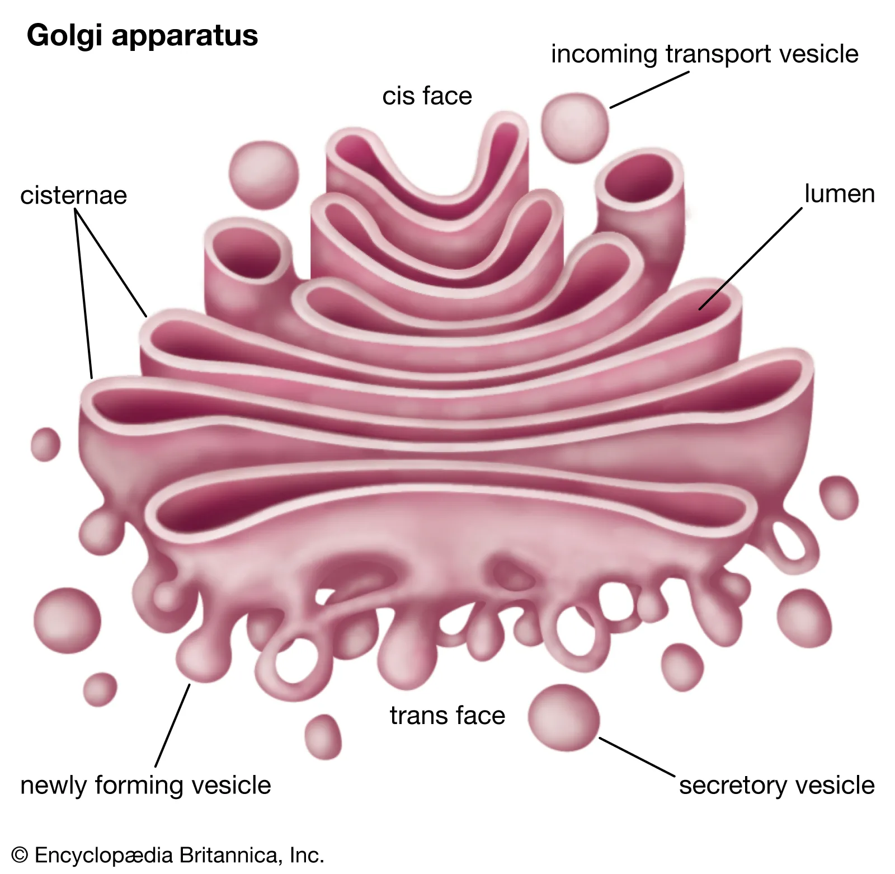
f. Peroxiosome
Formed by self replication from ER
Act as oxidizing organelle as H2O2 is present in peroxiosome
g.Golgi Apparatus
Made up of cisternae, tubules and vesicles
Function
-carry out processing of protein generated
in ER.

Slide 42
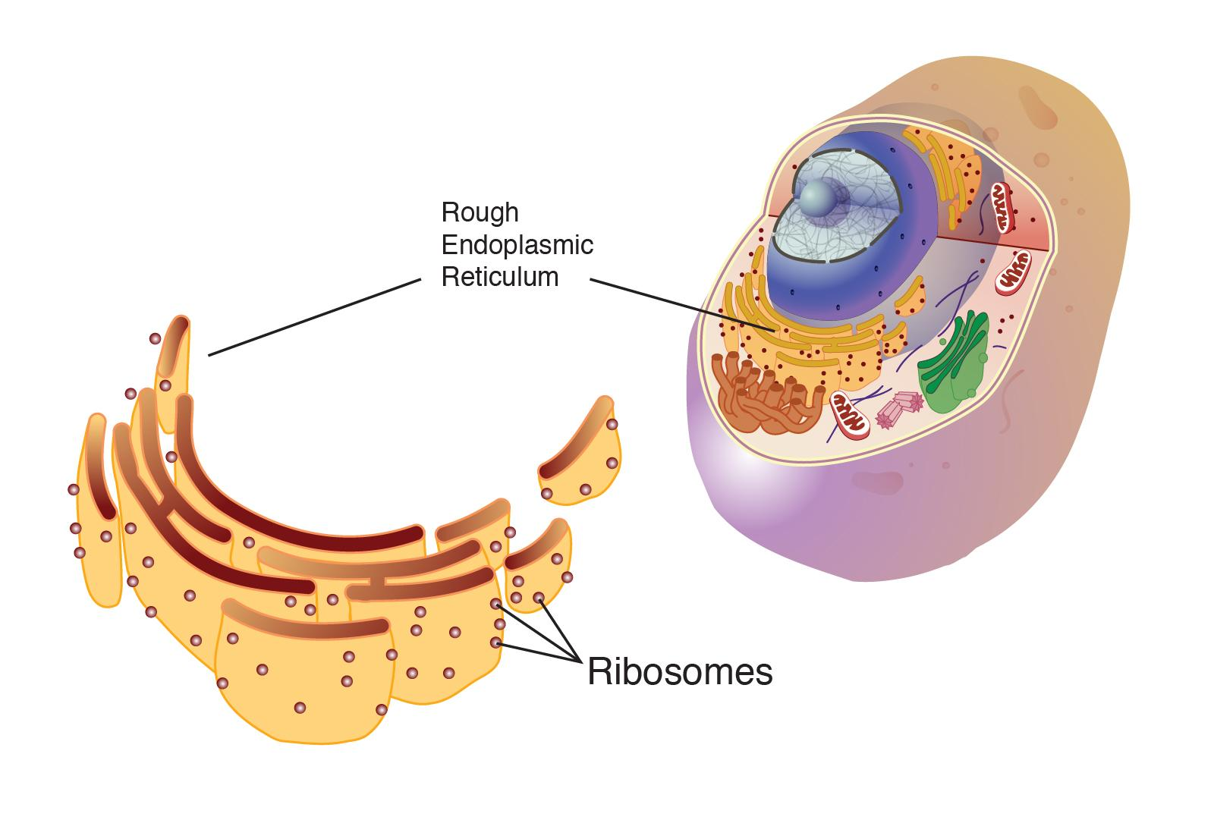
h. Ribosomes
Small granular organelle
Not enclosed ny membrane
Also called protein factory of cell
Function
Provides site of attachment of tRNA and
mRNA during protein synthesis

Slide 43
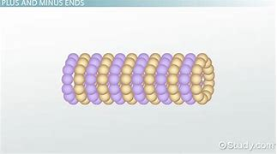
i. Microtubules
Unbranched, amembranous structure
Made up of tubulin proteins α and β
Function
Maintain shape of cell
Help in movement of nuclei during cell division

Slide 44
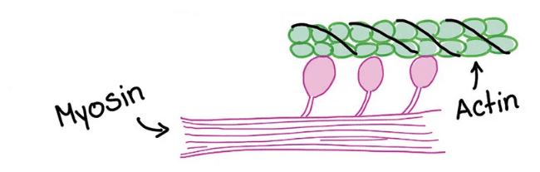
j.Microfilament:
Long,narrow ,thin, a membranous structure
Made up of actin protein and myosin protein
Function
Maintain shape of cell
Help in exocytosis and endocytosis
Contraction of muscles

Slide 45
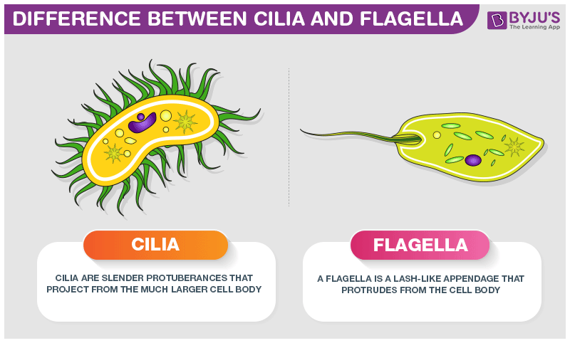
k. Cilia and Flagella
Microscopic, hair or thread like motile structures
Function
Involve in locomotion, feeding and protection

Slide 46
EPITHELIAL,MUSCLE AND NERVOUS TISSUE

Slide 47
EPITHELIAL TISSUE

Slide 48
Characteristics of epithelium
•Polarity
Apical surface
Basal surface
•Supported by connective tissue
Basement Membrane

Slide 49
•Specialized junctions
Occluding (Tight) ,
Adhering (anchor) ,
Desmosome (anchor),
Channel (Gap)
• Avascular but innervated
• Regeneration

Slide 50
Classification of Epithelium
Based on the cell-shape
1.Squamous – are flat and scale-like
2.Cuboidal – are box-like (same height and width)
3.Columnar – are tall (column shaped)
Based on the number of layers
1. Simple – single layer
2. Stratified – ≥ two layer
3. Pseudostratified – single layer but illusive as multilayered

Slide 51
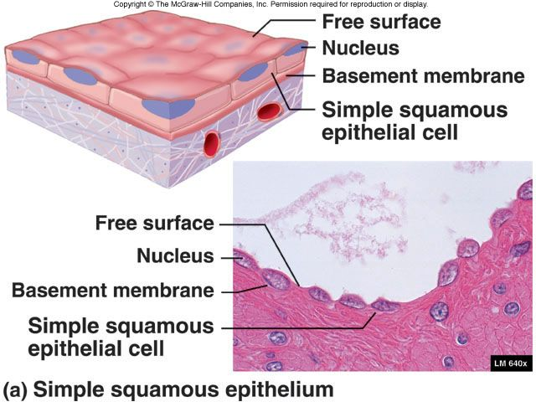
Simple squamous epithelium
Function :
• facilitates for filtration
Location :
• lining of capillaries,
. alveoli (lungs)
• glomeruli (kidney)

Slide 52
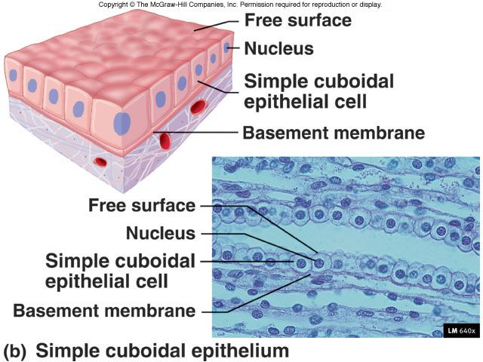
Simple cuboidal epithelium
•Function :
secretion and absorption
Location :
Thyroid gland, and kidney tubules

Slide 53
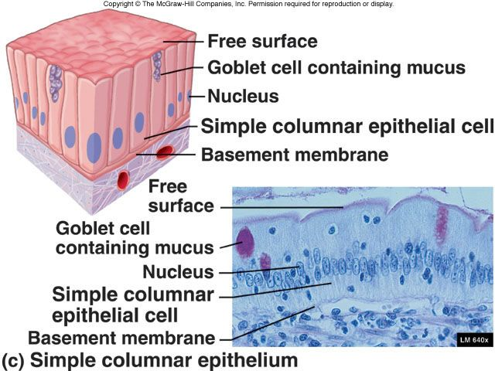
Simple columnar epithelium
- Function
absorption and secretions
Location :
Digestive tract
;Example: stomach
(Simple columnar with microvilli/ circular folds)
Reproductive tract
Fallopian tube Uterus (Ciliated simple columnar)

Slide 54
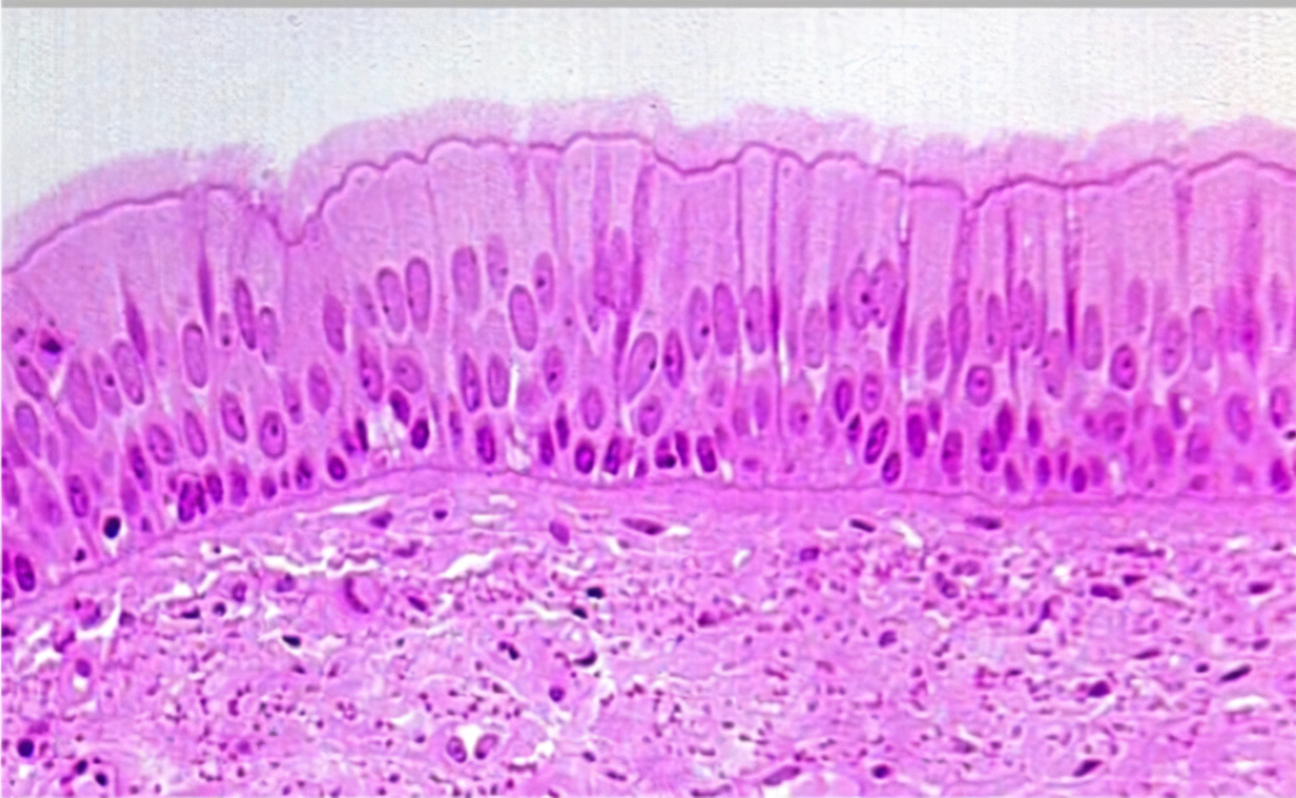
Pseudostratified epithelium
Function:
Secretion and absorption
Location:
Upper Respiratory Tract: Trachea,
Vas deferens
- Ciliated
- Cells have different heights giving illusion of multiple cell layers

Slide 55
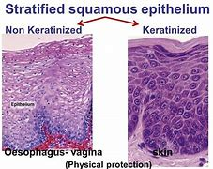
Stratified squamous epithelium
Basal to Apical side (Columnar – cuboidal – squamous epithelial cells)
Functions :
Barrier, Protective layer
Non-keratinized
• Cornea
• Oral cavity
• Esophagus
• Anal canal
• Inner side of lips

Slide 56
Keratinized
• Palm
• Hand
• Sole of foot

Slide 57
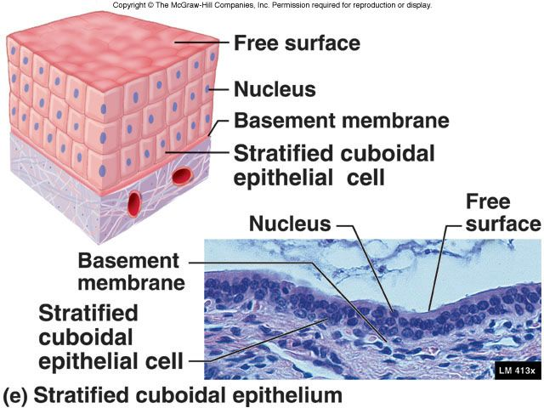
Stratified cuboidal epithelium
- Two layers of cuboidal cells
• Function :
Secretion
• Location :
Ducts of sweat glands,
Mammary glands

Slide 58
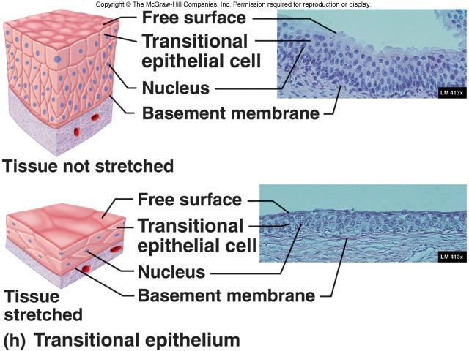
Transitional epithelium
Location :
In the lining of Urinary system (urothelium)
- Basal side : columnar/cuboidal
- Middle layers: polyhedral
- Apical side : Umbrella shaped (flattens
completely during distension)
Function :
The transitional epithelium cells stretch readily
in order to accommodate fluctuation of volume of the urine in the bladder

Slide 59
Endocrine Glandular Epithelium
Ductless - Complex aggregation of glandular epithelial cells that later lose connection with the surface
Function
Secretion of hormones - Products are released direct to the bloodstream
Location ;
Thyroid gland Pituitary gland

Slide 60
Exocrine Glandular Epithelium
Function
Secretion : Secret water based fluid containing proteins
Location
Sweat gland,
salivary gland

Slide 61
Muscular tissue

Slide 62
Muscular tissue
Functional Characteristics
Excitability: an ability to respond to stimuli.
Contractibility: an ability to shorten and thickent.
Extensibility: an ability to lengthen
Elasticity: an ability to return to its resting state.

Slide 63
Muscular tissue
Composition of each muscle fiber
•Sarcolemma •Sarcoplasm •Sarcoplasmic Reticulum
Cell Membrane Cytoplasm Endoplasmic Reticulum

Slide 64
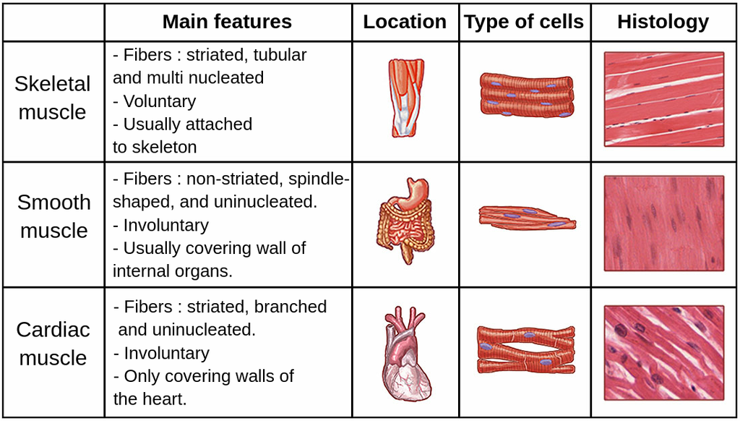
TYPES OF MUSCLE

Slide 65
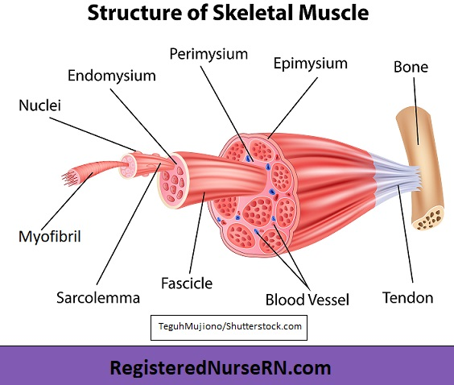
Skeletal Muscle
Long, cylindrical, multinucleated muscle
Fibre
1. Covered by the connective tissue,
called endomysium
2. Each fasciculus is comprised of
bundles of muscle fibres,
covered by perimysium
3. The whole muscle fasciculi
are covered by the Epimysium

Slide 66
Each skeletal muscle fibre is comprised of longitudinal myofibrils
Each myofibril is comprised of contractile components; -Actin and Myosin
Myosin – thick filament,
Actin – thin filament, gives the appearance
of cross striations in the histological slide
-These two filaments overlap each other
their ability to slide past each other forms the basis of the theory of
muscle contraction and relaxation

Slide 67
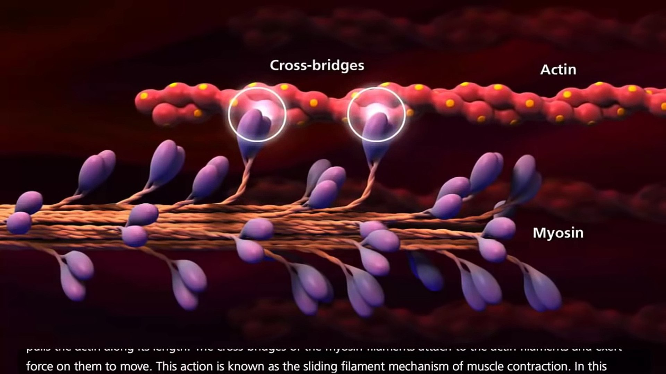
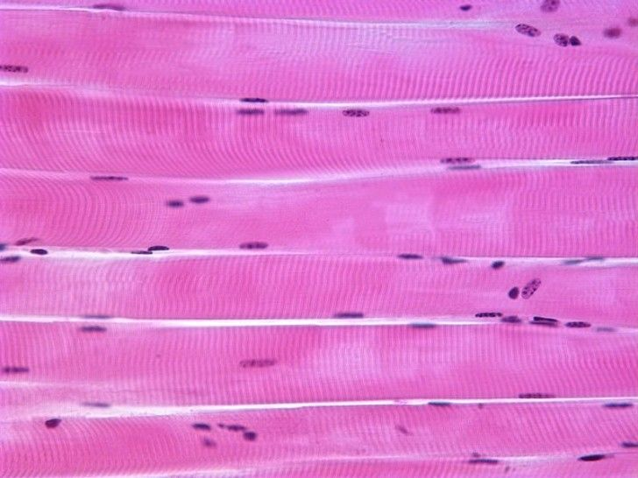
Fig; Sliding Filament of Actin and Myosin
Skeletal Muscle
ffSkeletal Muscle
Fig; Skeletal muscle

Slide 68
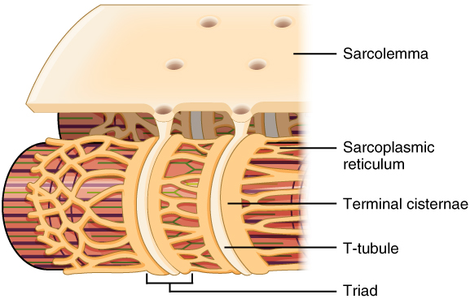
Sarcomere
It is the basic unit of myofibril composed of sliding protein filaments; actin and myosin, between two Z lines (where the tails of actin filaments are attached).
Centro-tubule (T) system –
- Invagination of sarcolemma around
myofibril
- provides uniform contraction
(diffusion of the depolarized signal)
Sarcoplasmic reticulum –
- In the form of network around the myofibrils
- release the ca2+ throughout

Slide 69
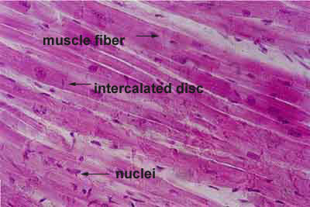
Cardiac muscle
•
• Long, branched
• Intercalated disc
: thickening of sarcolemma at adjoining regions
• Cross striations
• Sarcoplasmic reticulum is less prominent
• Involuntary
autonomic nerve supply
• Distribution
myocardium of heart

Slide 70
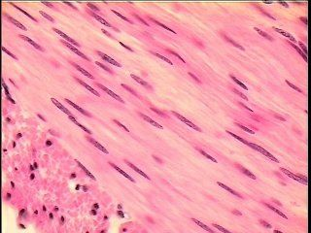
Smooth muscle
••Elongated with spindle shape
• No Intercalated disc
• Connected by gap junctions : forms syncytium
• Non cross-striated muscle
longitudinal striations are present
• Sarcoplasmic reticulum is less prominent
• Involuntary
autonomic nerve supply
• Distribution :
hollow viscera, iris, ciliary muscles
and vessels

Slide 71
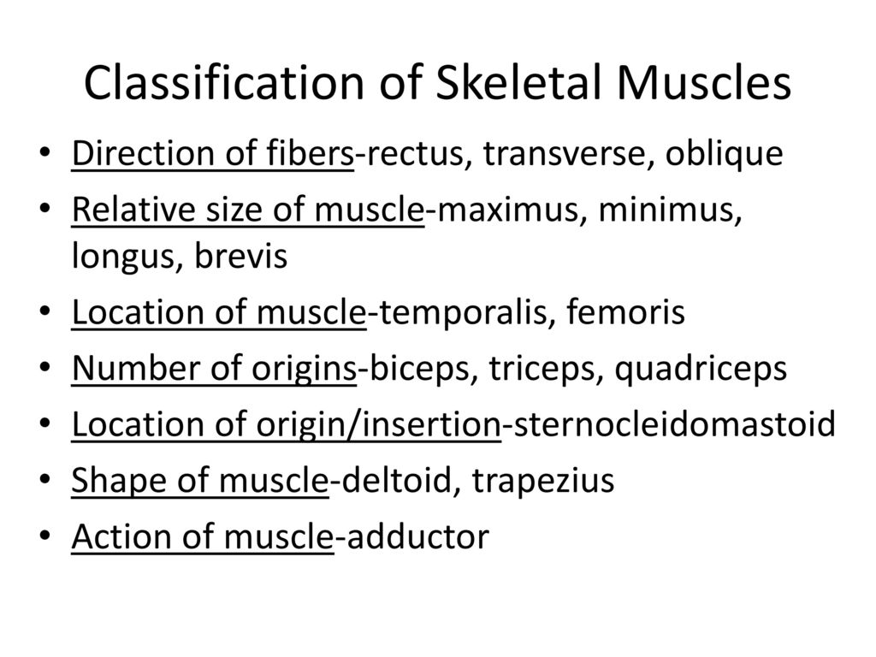
Classification of SKELETAL muscle
On the basis of:

Slide 72
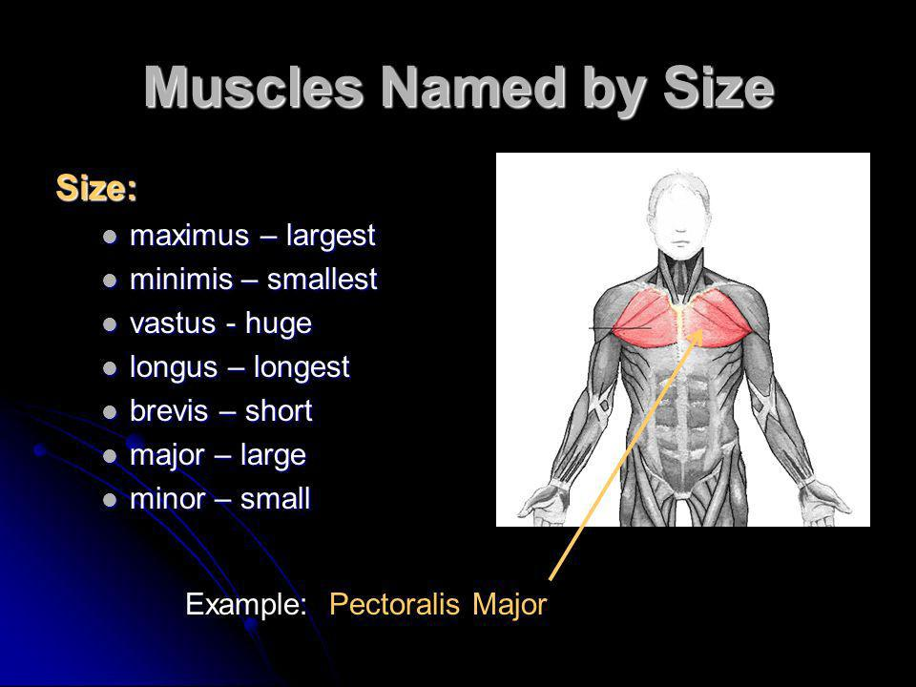

Slide 73
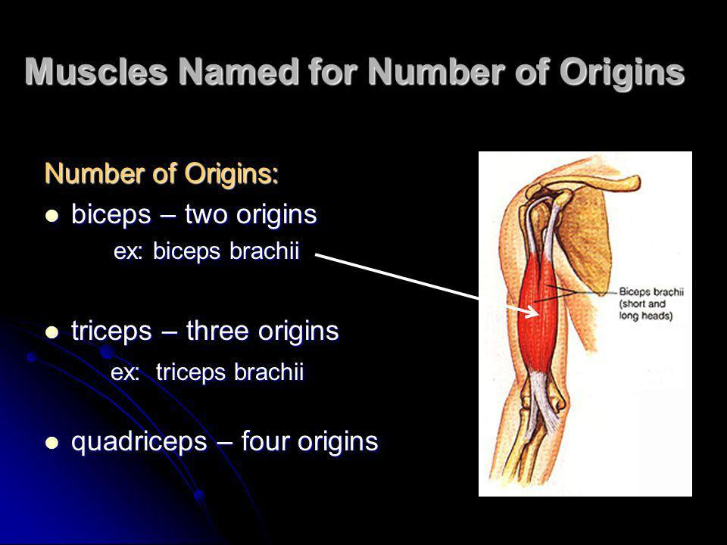

Slide 74
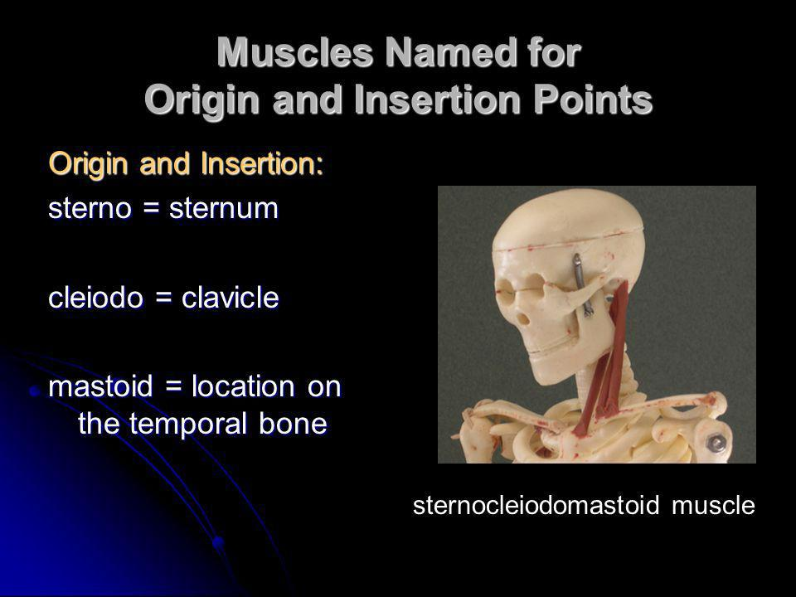

Slide 75
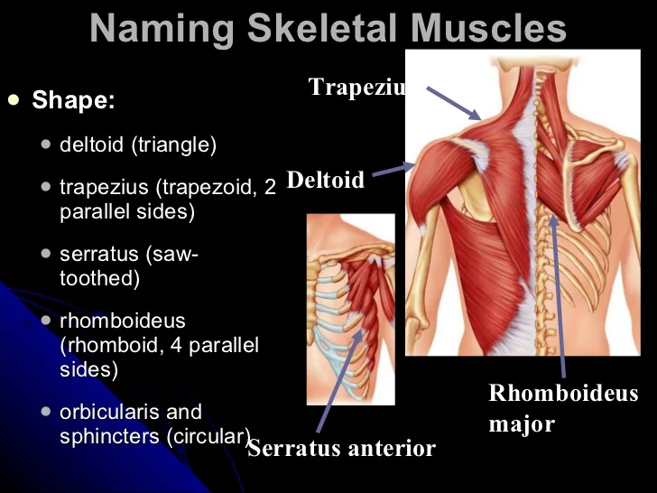

Slide 76
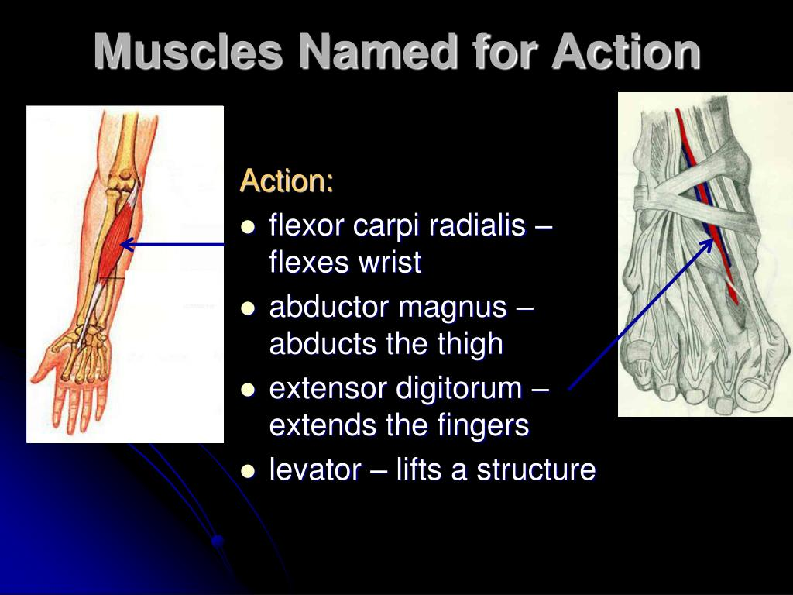

Slide 77
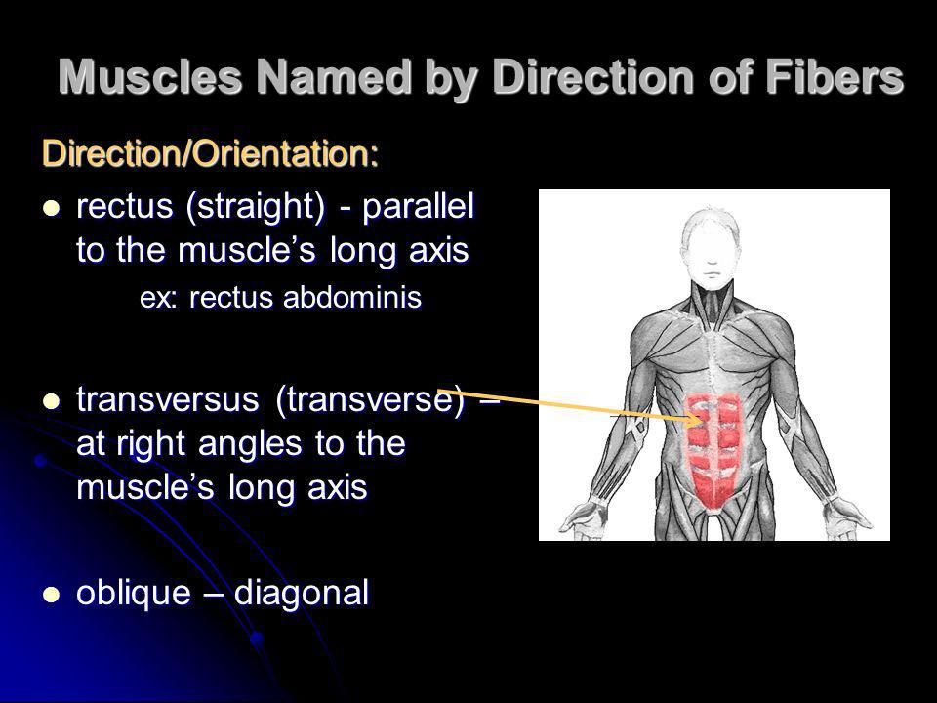

Slide 78
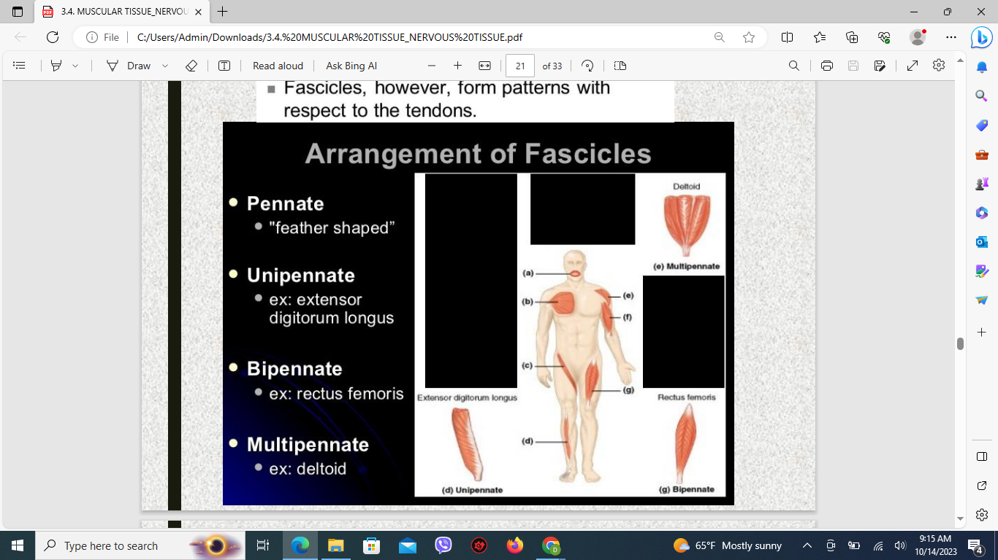

Slide 79
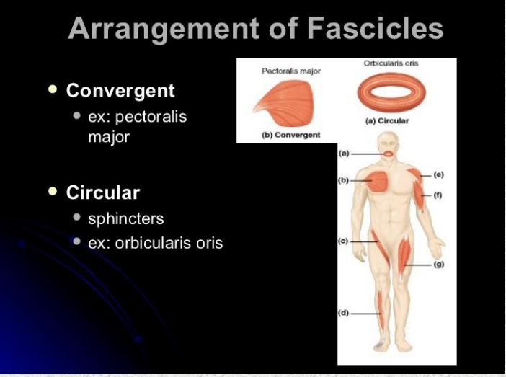

Slide 80
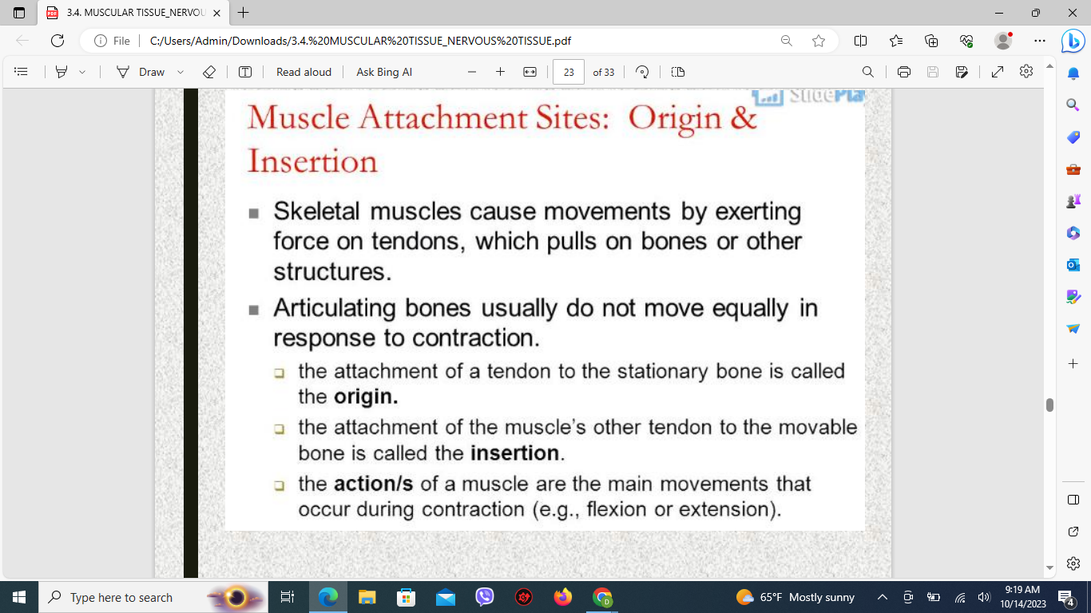

Slide 81
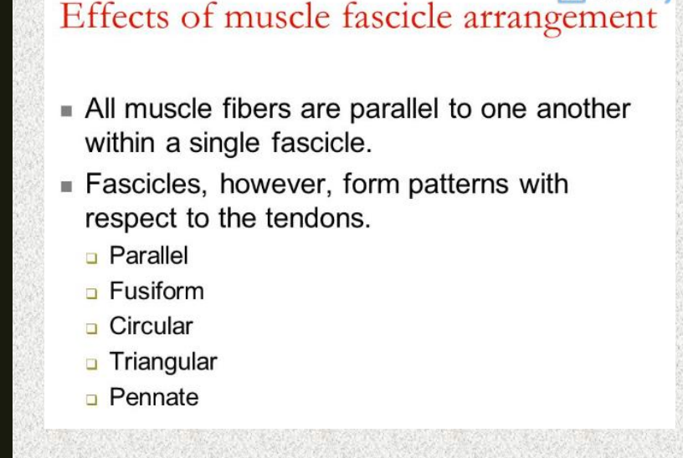

Slide 82
NERVOUS TISSUE

Slide 83
NERVOUS TISSUE
Components
Neurons
Excitable cells
Neuroglia
non-excitable cells
1. Astrocytes
2. Oligodendrocytes
3. Schwann cells
4. Microglia
5. Ependyma
6. Satellite cells

Slide 84
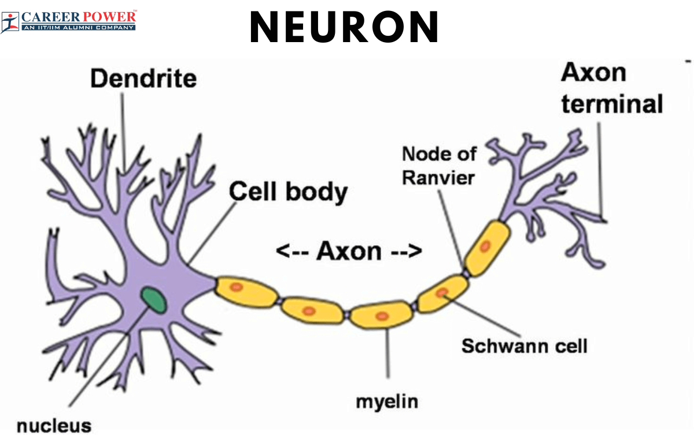
Neuron
Structure

Slide 85
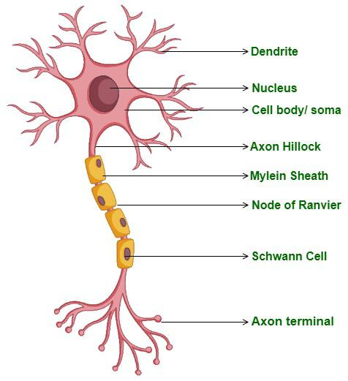
• Cell body (soma, perikaryon)
Nissl granules (Nissl bodies)
abundant granular ER
Neurofibrils
microfilament/ microtubule
• Neurites –
Dendrites
Nerve impulse travel towards cell body
Axon
Nerve impulse travel away from cell body
Myelinated and unmyelinated
Axon hillock, Axolemma, Axoplasm

Slide 86
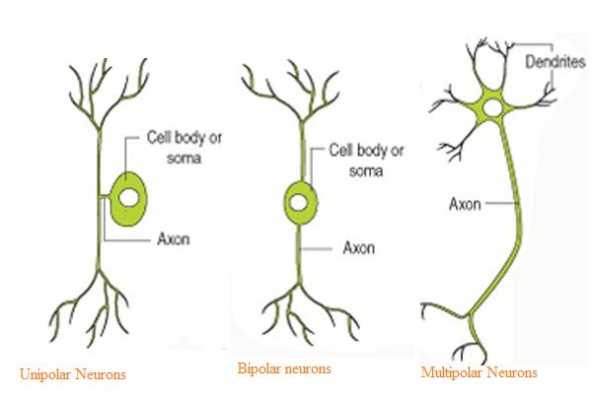
Neurons
Morphological classification
• Unipolar :
Sensory ganglia (dorsal root ganglia)
• Bipolar :
olfactory epi, Retina
• Multipolar :
Autonomic ganglia

Slide 87

• Unipolar, arranged in groups
• Satellite cells around the
neuronal cell body
• Multipolar, arranged in scattered form
• Satellite cells around the neuronal cell
body (lesser than the unipolar)

Slide 88
Neurons
Classification on the basis of length of axons
Golgi type I
- long axons
- connect remote regions
e.g. pyramidal cells of cerebral cortex to spinal cord
Golgi type II
- short axons
- connect nearby regions
e.g. association fibers of the cerebral cortex

Slide 89


Neuroglia
• Present in PNS
• Involve in one myelination sheath
• Present in CNS
• Involve in several myelin sheaths

Slide 90

Ependymal cells –
lining of the ventricles and central canal
Astrocytes –
Protoplasmic & Fibrous
Blood brain barrier
Capsular cells/Satellite cells –
supports of cell bodies
Microglia –
Phagocytosis

Slide 91

THANK YOU

